Slide 1
General controls of current space games
Current space games controls based on an PC platform use the arrow keys and/or W,A,S,D keys to move there spaceship around the map/level.
Most space games either use the space bar key or the mouse to fire there spaceships weapons.
The slide below represents this

Slide 2
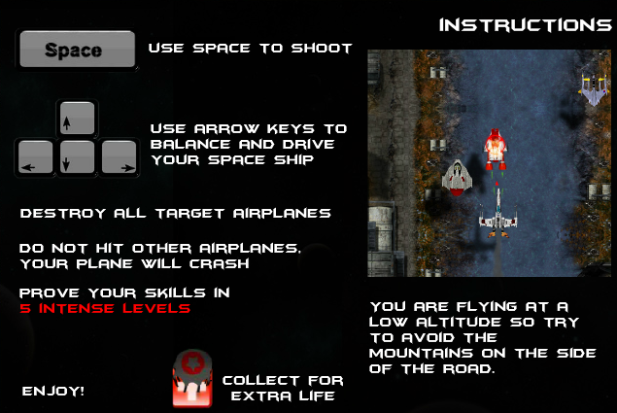
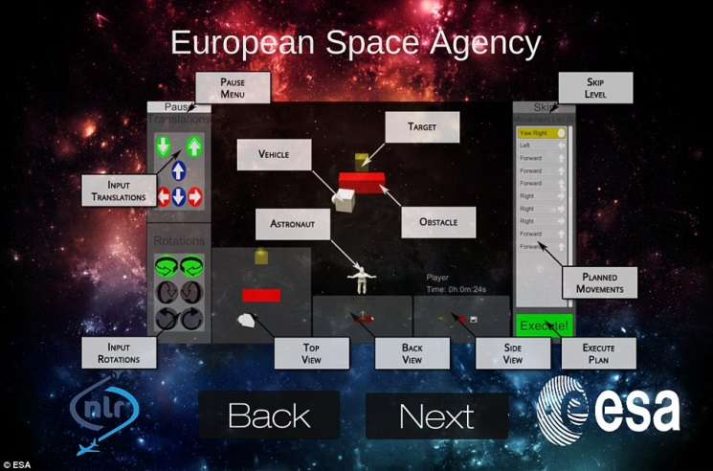
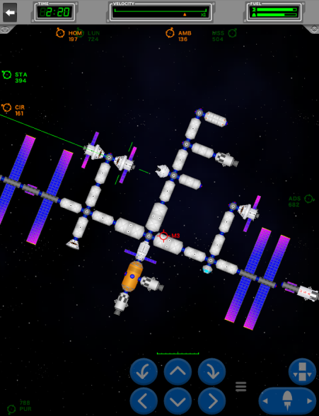
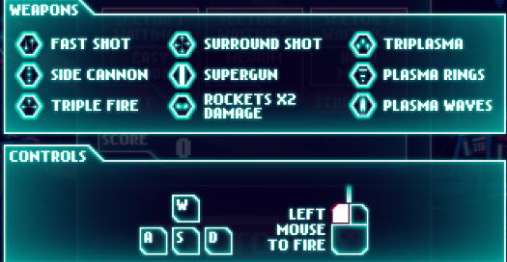
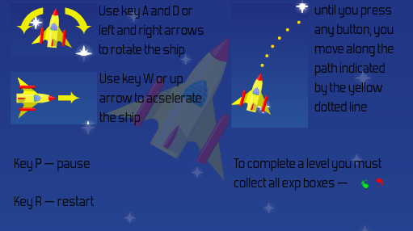
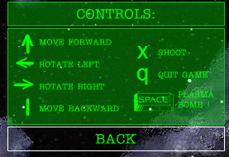
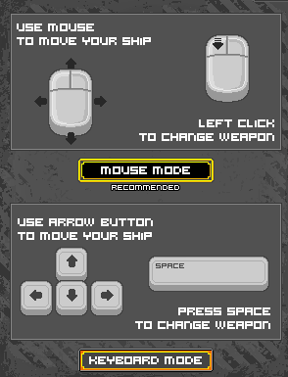
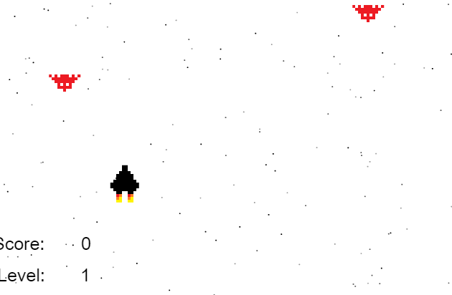
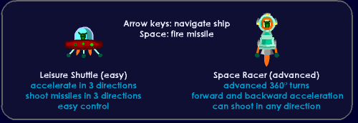
Controls
Here's some current games that use normal controls.
A few game like Galaxy Gun have different controls or let the player choose what controls they would like to use.

Slide 3
Possible USP’s for controls.
Players have a varied choice on what controls they would like to use
Players can create there own controls so it suits them.

